Slide 1
Do this
Not that
Presented by: The Financial Aid Office

Slide 2


Attendance
DO THIS
NOT THAT
Notes:
Not attending classes not only impacts you academically but also has monetary consequences. On average one class session of a 3 credit undergraduate course costs about $150. So missing one class is like paying $150 and receiving nothing in return. Miss too many classes and you may be subject to an administrative failure. Not to mention having to retake the course

Slide 3


Grades
DO THIS
NOT THAT
Notes:
Think of your education as an investment. The more you put into it the greater the payoff. Grades not only impact your GPA but your competiveness for internships, job and scholarship prospects. Poor grades can cost you thousands.

Slide 4


Housing
DO THIS
NOT THAT
Notes:
Have roommates. Living on or off campus with roommates can save money with both rent and utility expenses. Choose your roommates wisely and always have agreements in writing regarding how expenses are divided. Look around for the best prices in housing.
When you live by yourself, you’re responsible for all the costs (rent, food, cable, internet, phone, electricity, gas, etc). Many college students spend most of their time on campus, so spending a lot on housing is unnecessary.

Slide 5



Food
BUY THIS
NOT THAT
Notes:
Purchasing and using an AU meal plan can help cut down costs, as many times it’s cheaper to eat on campus than off (even at fast food places). Buying snacks for your dorm room or cooking some meals yourself can also save your budget. Be sure to buy generic brands, as many times they are cheaper than name brands.
Eating out gets expensive! A dinner out can cost $20 per meal each time. When you multiply that by 21 meals a week ($420), buying groceries is a better bet.

Slide 6



Books
BUY THIS
NOT THAT
Notes:
Renting text books is an excellent way to save money. If you choose to buy text books, to look at around to get the best price. Used books may also be a good option for keeping costs down.

Slide 7


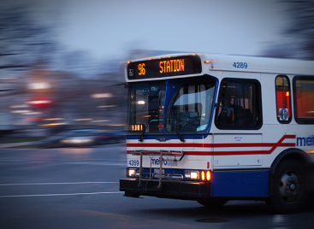
Transportation
USE THIS
NOT THAT
Notes:
For the cheapest and healthiest form of transportation, walk or ride your bike. A second best choice is to use Metro or Metro Bus.
While taking a taxi maybe the quickest way of arriving at your destination, it also is one of the most expensive. If you are taking a cab, try to split the cost with friends.
Having a car on or off campus can be quite costly. Parking, gas, insurance and maintenance costs are just a few of the expenses that you’ll encounter. Carefully weigh all of your transportation needs and options before plunging into car ownership

Slide 8


Clothing
BUY THIS
NOT THAT
Notes:
Check some less expensive stores, you’ll be surprised what you can find. Also keep an eye for sales and clearance racks.
Paying full price for name brands adds up quickly. You can be a fashionista, but look for good deals.

Slide 9


Working
BE THIS
NOT THAT
Notes:
Understand that every little bit you earn assists you in paying for school and other things you will need throughout the year. If possible think about working part-time in school or over the summer.
Studies show that students who work while in school are more successful in school because it helps with time management and builds good study habits.

Slide 10
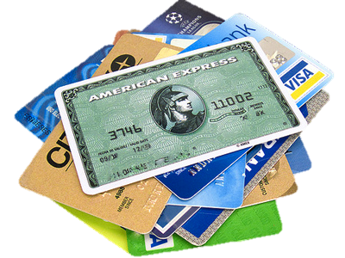

Paying
USE THIS
NOT THAT
Notes:
Cash! Using a cash budget is always beneficial as it prevents over spending. Knowing cash is finite, once it’s gone, it’s gone.
Credit cards can be dangerous. It’s difficult to track spending and there are often fees that can quickly add up.
While debit cards may seem like you’re using cash, it can be difficult to keep up with just how much you’ve spent. You run the risk of overdraft fees if you’re not careful.

Slide 11


Loans
USE THIS
NOT THAT
Notes:
If possible, use payment plans instead of loans. However, federal loans (Stafford, Perkins, PLUS) can be a good way of helping you pay for college. These loans have lower interest rates and more generous terms of repayment.
Private bank loans are dangerous. Securing these loans generally requires a co-signer. When it’s time for repayment, You’ll have fewer options. Think of these loans as last resort measures.

Slide 12


Bills
DO THIS
NOT THAT
Notes:
Stay within your budget. When bills arrive, pay in full, on time. This will prevent interest from accruing and fees from multiplying. It will also help establish a strong credit history.
Shiny, pretty things are awesome to give and receive. Before making an unnecessary purchase, make sure all your bills have been paid and double check your budget.

